Slide 1
OSR Training #1
Processes & Properties

Slide 2
Why are Plastics used as alternatives to Metals?
Extend Part Life
Reduce/Eliminate Lubrication
Extend Life of Mating Parts
Reduce Weight
Solve Corrosion Issues
Provide Electrical Insulation/ESD
Provide Thermal Insulation

Slide 3
Thermoplastic Materials

Slide 4
Amorphous vs. Crystalline
Clarity
Toughness
Thermoformable
Poor Wear Resistance
Poor Chemical Resistance
Poor Abrasion Resistance
Static/Structural
Wear Resistance
Abrasion Resistance
Chemical Resistance
Opaque
Low Coefficient of Friction
Thermoforming/
  Welding
  Dynamic/Wear

Slide 5
Injection Molding
Strengths
Highest Mechanical Properties
Large Volumes
Thin Cross Sections
Weaknesses
Highest Stress
Limited Length
Thin Cross Sections
Poor wear resistance

Slide 6
Extrusion
Strengths
Continuous Lengths
Lower stress than Injection Molding
Standard Shapes
Cost Effective
Weaknesses
75% of Injection Molded Strength
Minimums on Non-Standards
Rod may have camber

Slide 7
Compression Molding/ Ram Extrusion
Strengths
Least Stress
Small Runs
Heavy Cross Sections
Only way to process some materials
Ram Extrusion provides long lengths
Weaknesses
50% of Injection Molded Strength
May cause brittleness
Thin Cross Sections are difficult in some materials
Slow process

Slide 8
Casting
Strengths
Cost effective for Heavy Cross Sections
Only way to process some materials
Low stress
Broad size and shape availability
Weaknesses
Thin Cross Sections very difficult
Limited material choices
One piece at a time
Broad tolerances due to shrinkage

Slide 9

So. Many.
Plastic Parts!

Slide 10
Terms
Strength
vs.
Design Strength
  Tensile
  Flexural
  Compressive
Modulus
vs.
Apparent Modulus
  Tensile
  Flexural
  Compressive

Slide 11
Strength
Compressive Strength
Flexural Modulus
PTFE 1,600
UHMW 3,000
Nylon 14,000
Acetal 15,000
PET-P 15,000
PEEK 20,000
Torlon 5030 38,000
PTFE 72,000
UHMW 110,000
Acetal 450,000
PET-P 490,000
Nylon 500,000
PEEK 600,000
T 7130 2,720,000

Slide 12
Terms
Wear (K-Factor)
Abrasion (Sand Slurry)

Slide 13
Abrasion and Wear
Sand Slurry (Abrasion)
K Factor (Wear)
UHMW 10
Nylon 44
PET-P 65
PTFE 78
Urethane 89
Carbon Steel 100
Acetal 135
Torlon 4301 10
PET-P 60
Nylon MD 70
Nylon 72
UHMW 125
Acetal 200
HDPE 490

Slide 14
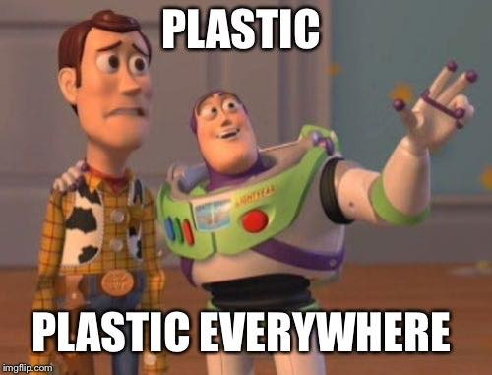

Slide 15
Terms
Thermal Properties
  Continuous Use Temperature
  Heat Deflection Temperature
  Glass Transition Temperature
  Thermal Conductivity

Slide 16
Thermal Properties
CUT (F) Tg (F)
PTFE 500 68-75
UHMW 180 115
Nylon 200 145
Acetal 180 150
PET-P 210 180
PEEK 480 290
Torlon 500 532

Slide 17
What is the effect of operating above Tg?
Strength
Stiffness
Thermal Stability
Wear Resistance
Abrasion Resistance
Chemical Resistance
Impact Resistance

Slide 18
Thermal Comparison

Slide 19
Terms
Dimensional Stability
  CLTE
  Moisture Absorption
  Modulus
  Stress

Slide 20


Slide 21
Terms
Limiting PV
  Pressure x Velocity
  Pressure vs. Velocity
Additional Factors
  Temperature
  Thermal Stability
  Coefficient of Friction
  Chemistry

Slide 22
Fillers
Material Gain Loss
Glass Strength,Stability Toughness,Wear
Moly. Disulphide Rigidity,Stability Purity,Abrasion
Carbon Strength,Stab., Wear Elong., Abrasion
Graphite Stability, Wear Toughness, Abr.
PTFE PV, Wear, C of F Strength, Stab.
Polyethylene PV, Wear, C of F Strength, Stab.
Oil PV, Wear, C of F Strength, Rigid.
Mica Strength, Stability Tougness,Abras.

Slide 23
Effect of Fillers

Slide 24


Slide 25
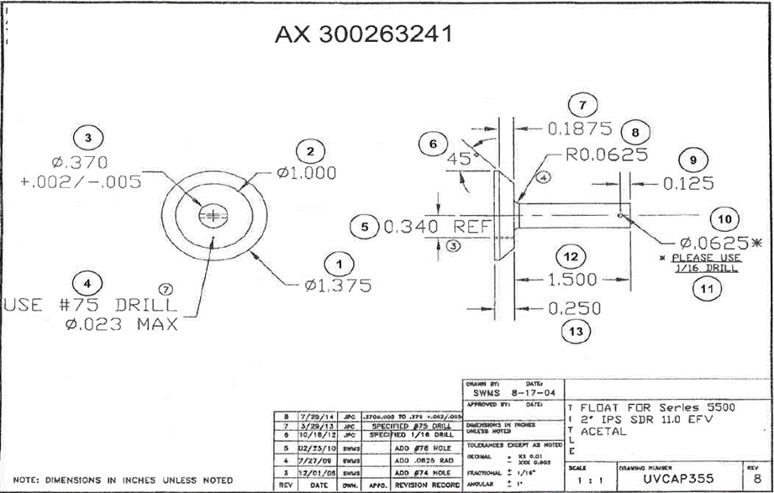

Slide 26
